Slide 1
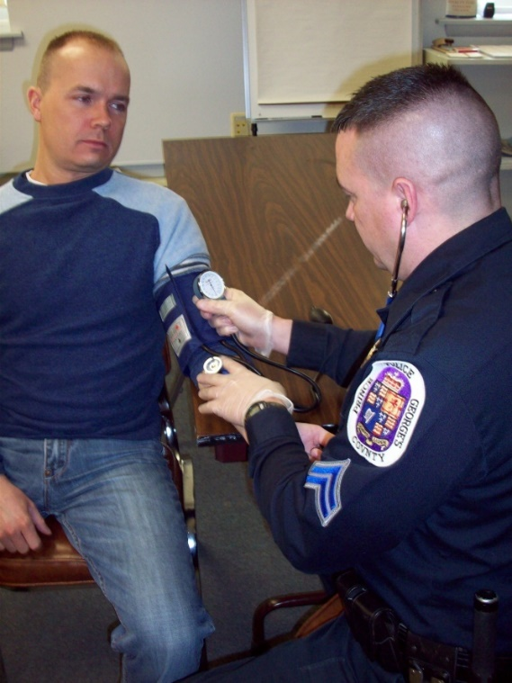
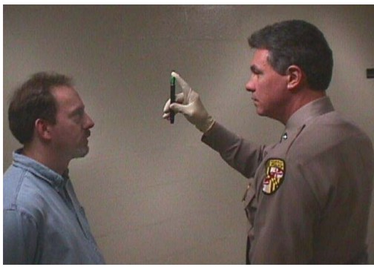
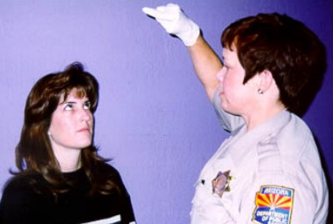



Session 27
Practice - Test Administration

Slide 2
Learning Objectives
Administer selected portions of the examinations that constitute drug influence evaluation
Describe evaluation procedures
Document results of examinations

Slide 3
Procedures for this Session
Participants will work in teams
At any given time, one member will be conducting and recording exams of the other member
Third member of team will coach and critique conducting member
Participants take turns performing each role

Slide 4
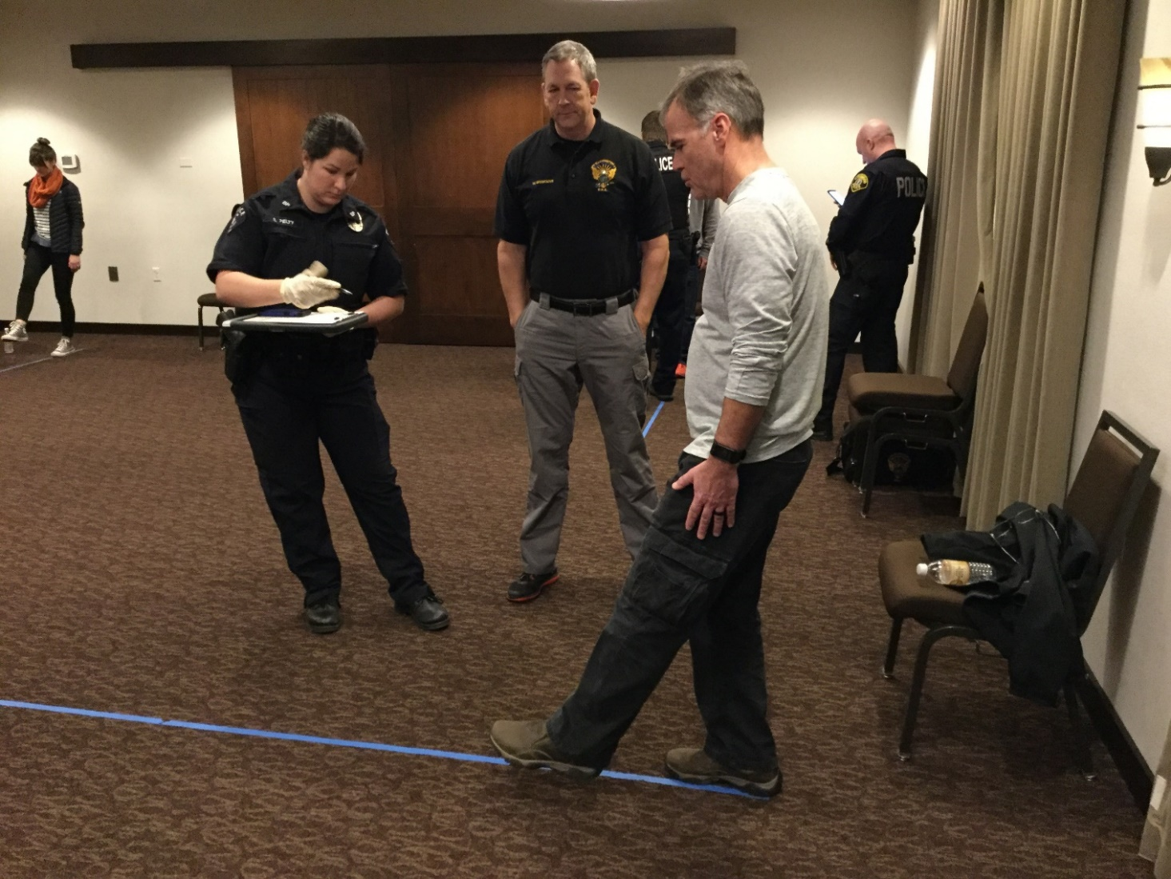
Hands-On Practice

Slide 5
Questions?

